Slide 1
CS5223 Distributed Systems
Lecture 3: OS Support for Distributed Systems -- Processes and Threads
Instructor: YU Haifeng

Slide 2
Today’s Roadmap
Chapter 3 of textbook
Review of processes in operating systems
Threads and light-weight process (LWP)
Multi-threaded servers
Designing servers
Code migration

Slide 3
A Brief Review on Processes
Process: a program being executed in its own virtual memory space
Historical goal: Allow multiple users to share the same CPU (computers were expensive!)
Emphasis: Isolation and protection
Process control block (PCB): contains information associated with a process
program counter (PC)
stack pointer (SP)
CPU registers
open files
memory allocation information (code, stack and data)

Slide 4
A Brief Review on Process State
Running: instructions are being executed
Waiting: process is waiting for some event to occur
Terminated: process has finished execution
Ready: process is waiting to be assigned to a processor
running
ready
terminated
waiting

Slide 5
Processes Are Expensive: Creation Cost
Need to create independent address space
New mapping between physical memory pages to virtual memory pages
Need to allocate and maintain open file information for the process
A typical OS can thus only support small number of processes (e.g., a few hundreds)
Historical perspective: We did not care because processes were long running (e.g., long running simulation)

Slide 6
Processes are Expensive: Context Switching
When a CPU switches from process P1 to P2, it
saves the state of P1, loads the state of P2, starts execution of P2
Switching requires
Trapping into the OS (why?)
Saving and changing memory mapping
Saving and changing open file table
Saving and changing CPU context (e.g., register values, program counters, stack pointer)
Historical perspective: We did not care because processes do not tend to switch so often

Slide 7
Processes are Expensive: Inter-Process Communication
Processes often need to communicate/collaborate with other processes
Word may hand over the file to a spooler (daemon) process which sends the file to the printer
In a simple distributed game, we may have two processes (one for each player), and each process may need to periodically update the other process
Inter-process communication is usually expensive
Because we wanted to isolate / protect processes from each other
A process takes extra precaution when communicating with other processes
Usually involve trapping to the OS – directly updating some common data is not usually an option

Slide 8
Why We Care
Interactive applications (such as graphic user interface)
Each window may corresponds to a process
Each mouse click may trigger a context switch
MS Windows
Distributed applications (such as web servers)
Each web request may require the creation of a new process
Each message sent over the network is an I/O operation and may trigger a context switch
Apache web server
Fundamental reason:
“Embarrassingly parallel” applications can no longer afford the overhead
Same application: Protection/isolation no longer needed

Slide 9
Solution: Threads
Each process contains multiple threads of execution
Goal of threads: Allow parallelism with a low cost
(Goal of processes: Isolation and protection)
The state of a thread contains
Value of program counter (PC)
Value of CPU registers
Value of stack space
All threads in the same process share
Virtual memory space
Code section
Data section (heap space)
Operating system resources, e.g., open file

Slide 10
Processes and Threads
computer
computer
process
process
Program counter
A traditioanl process can be viewed as a process with a single thread
thread
All threads within the same process are supposed to be cooperative – No protection is provided!
Will you run downloaded code in a process or thread?

Slide 11
Threads Are Cheap: Creation Cost
No need to create independent address space
Use the same address space with other threads
Cost amortized
No need to allocate and maintain open file information
All threads in the same process
Threads can be implemented entirely in the user-level (not visible to the OS)
Java Virtual Machine being a prominent example
Can have thousands of threads

Slide 12
Threads Are Cheap: Context Switching
Process context switching requires
Trapping into the OS
Saving and changing memory mapping
Saving and changing open file table
Saving and changing CPU context (e.g., register values, program counters, stack pointer)
Thread context switch requires
Saving and changing CPU context (e.g., register values, program counters, stack pointer)

Slide 13
Threads Are Cheap: Inter-Process Communication
Threads in the same process see the same virtual memory (shared memory)
Can exchange information by updating the shared memory
Extremely simple (and cheap) memory read/write operations
No OS intervention is needed
In Java, a thread can access any shared memory that it has a pointer to
A thread may corrupt the shared memory and cause all threads to fail

Slide 14
Implementing Threads
User-level threads
Usually implemented as a thread library or a thread package
Kernel-level threads
Hybrid (lightweight processes or LWP)
The term LWP has been defined by different people with different meaning
We will stick with the definition on Tanenbaum book

Slide 15
Kernel-level Vs User-level Threads
user-level
Threads package
OS kernel
Threads package

Slide 16
Implementing User-level Threads
Creation, deletion, context switch of threads are done at user level as a library (i.e., thread package)
Threads are not visible to OS
Example:
Some UNIX have user-level thread packages
Java
Pros:
No OS modification required
Cheap to create, destroy, and context switch threads
Cons:
User CANNOT interrupt a thread (no way to preempt a thread if it hangs)
Invocation of blocking system call will block all threads in that process

Slide 17
Avoiding Blocking All Threads
read(file, buffer);
// return immediately
if (file.readComplete)
continue;
else
switch to another thread
OS can provide non-blocking systems calls
Example: non-blocking file read and write and then provide a polling mechanism
OS can provide upcall to the thread package
Tell the thread package that the thread is blocked
Will also notify the thread package when the thread is unblocked
Both approaches need OS support – most modern OS do have such support

Slide 18
Implementing Kernel-level Threads
Example: OS/2
Pros:
No problem with blocking system calls
Cons:
Need extensive support from the OS
Thread creation/deletion entails system calls (more expensive that user-level thread creation/deletion)
User does not have control over thread scheduling (especially bad for real-time applications)
Scalability (OS kernel space sometimes cannot grow too big)

Slide 19
Implementing Threads Using the Hybrid Approach
Key problem with user-level threads: Will block on blocking system calls
OS does not see the n threads in a process P1 – it only sees a single process P1
After P1 invoking the blocking system call, OS will pick another process P2 to run – the thread package (in P1) does not get control back
Idea: We create multiple lightweight processes, so that P2 is created by the thread package as well.
The thread package still gets control back
How many LWP should we use?

Slide 20
The Hybrid Approach
Example: Solaris 2
OS has the notion of LWP as the unit of scheduling
A user-level process may have n threads and are associated with k LWP
thread
process
User space
Kernel space
LWP

Slide 21
Comparing the Hybrid Approach with User-Level Threads
The hybrid approach is a compromise
Inherits most of the pros of user-level threads
But still have the scalability concern
k needs to be larger than the number of potentially blocked threads

Slide 22
Using Threads in Distributed Systems
Multi-threading the client
Same motivation as using multiple process in non-distributed systems
Communication over the network is one kind of I/O
Prominent examples:
Retrieving a web page
Flashget, Netants: Both fair and unfair
Multi-threading the server (e.g., web server) is more critical
Simplified software structure
Improves performance

Slide 23
Multi-threaded Server: A Programming Paradigm
Multi-threaded software are usually harder to design / understand than single-threaded software
But server is an exception
Server accepts client request and send back a reply accordingly
Conceptually, each request is a “job” and the “job” is simple and small
Use one thread for each request
Much easier to comprehend than having a single thread that works on a “pool of jobs”
More on this subject later…

Slide 24
Multi-threaded Server: Exploiting “Embarrassingly Parallel Workload”
The server needs to do a larger number of small “jobs”
Each job may block on disk access and network access
Threads naturally exploits such parallelism
Processes are too expensive to exploit such parallelism
The overhead of doing a “job” may even be smaller than the overhead of creating a process

Slide 25
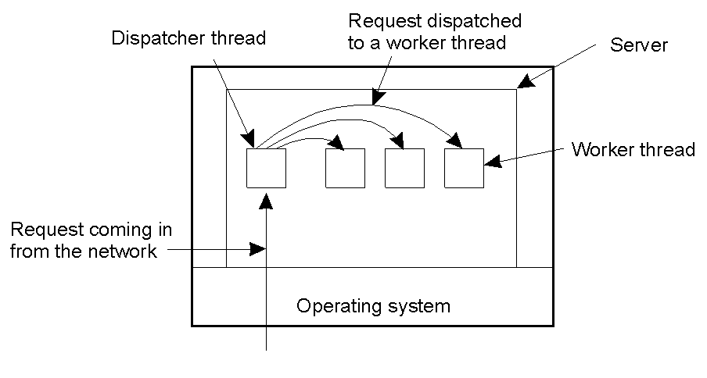
Multi-threaded Server Architecture
Not the only possible structure, but is indeed used prevalently (e.g., in Apache web server)

Slide 26
The Worker Thread Pool
Even creating threads are not free
The thread pool avoids overhead of creating and destroying threads
If thread pool is a good idea, why not use it in all multi-threaded software (such as your web browser, which is a multi-threaded client)?
Maintaining a thread pool ensures system stability over perk load

Slide 27
Event-Driven Server Architecture
Even (user-level) threads have context switch overheads
Saving & restoring CPU state
Saving & restoring stack pointers
how to eliminate all these
A single thread working on pool of requests
Assumes OS has non-blocking system calls
So-called event-driven architecture
The thread reacts to events (e.g., new jobs coming or completed I/O)

Slide 28
Pros and Cons of Event-Driven Architecture
Pros:
Better performance (e.g., a event-driven web server written in Java has 30% more throughput than a multi-threaded web server written in C)
Cons:
Hard to understand – most people are more comfortable with multi-threaded servers
There is a fundamental reason…later
Open question:
Whether the performance improvement is worth the complexity (and potentially more bugs)

Slide 29
Deeper Discussion on Event-Driven Architecture
What exactly is the different between multi-threaded server and event-driven architecture?
In event-driven architecture, the single thread needs to maintain stage information for each request
This is essentially a special case of the thread state in multi-threaded architecture
Even-driven architecture = A highly specialized user-level “thread” package
Source of performance gain: specialization
No need to save & restore irrelevant CPU states
Source of complexity: You are basically writing a simple thread package

Slide 30
History Readings (Non-compulsory)
SEDA:
Original paper on event-driven web servers
http://www.sosp.org/2001/papers/welsh.pdf

Slide 31
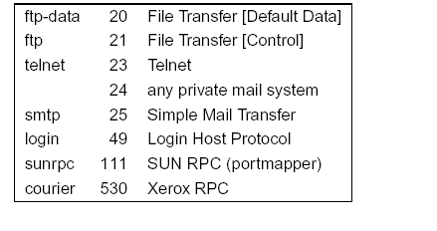
More on Server Design
We have discussed the architecture of a server
Multi-threaded and event-driven
Locating a server:
Finding the IP address – DNS (later)
Finding the port – well-known or use superserver

Slide 32
Out-of-Band Request
Is it possible to interrupt a server once it has accepted (or is in the process of accepting) a service request?
Use a separate port for urgent data (possibly per service request)
Server has a separate thread (or process) waiting for incoming urgent messages
When urgent message comes in, the associated service request is put on hold
Note: we require OS supports high-priority scheduling of specific threads or processes
We may also rely on out-of-band communication in TCP

Slide 33
Stateless and Stateful Servers
Stateful servers – record information about what previous requests a client have made
Stateless servers – do not record such information
May record some bookkeeping information which is not needed for correctness
Examples of stateful servers:
FTP servers (the server remember which directory you are in)
File servers (keeps track of which files you have opened)
ATM / Banking systems

Slide 34
Stateless Servers
Examples of stateless servers:
Web servers
Theoretically, we can always convert a stateful server into a stateless server
By requiring the client to include all past requests
Sometime this is indeed what we do when banking records are messed up
Web server send back cookies to clients, which the client will include in the next request

Slide 35
Pros and Cons of Stateful Servers
Pros:
Simplifies the job for the client
More efficient in some cases (e.g., file server and FTP server)
Cons:
Much more complex than stateless server
Extremely difficult to deal with server failures
E.g., to deal with failures in banking systems, we need a whole theory for database recovery
Extremely difficult to deal with client failures as well
E.g., client may crash when holding locks to a file

Slide 36
Choosing between Stateful and Stateless
Different states may have different requirements
The server can be stateful for some states but stateless for other
There are also intermediate design points: Session states
The state is only maintained within a session
Example: FTP (but not banking)
Generally, try to be stateless unless you have reasons not to be

Slide 37
Server Cluster/Farm
Many larger-scale services are provided by server clusters
Example: Search engine (google), Internet data center, large-scale E-commerce
Thousands of nodes or more
Typically use a three-tier architecture, but not always
Tiering provide modular design and a E-commerce site may have its own software for 2nd tier but 3rd party software for other tiers
Design choice: How to allocate machines to different tiers
Design choice: How to allocate requests to different machines
A lot of research on these (driven by vast commercial interests)

Slide 38
Server Cluster/Farm (continued)
Managing a server cluster/farm can be a nightmare
Nobody has a perfect answer
Google probably has the most experience and expertise on that
But proprietary not published
Challenges:
Heterogeneity
Frequent failures (there’s never a time when all nodes are up)
Lack of supporting software
An area with a lot of money

Slide 39
Code Migration: Motivation
Performance improvement
Process moved from heavily-loaded to lightly-loaded machine
Prominent examples: Java applet and game
Dynamic code migration: Migrate code based on current observation
Why we cannot do load balancing well enough
Load changing and unpredictable
Reduce communication
E.g. Database client-server system, move client application to operate on data to reduce network communication costs
Helps only if the code size is smaller than the data size

Slide 40
Code Migration: Challenges
Security
Heterogeneity
Dynamic code migration may cause threshing
Migration decisions are often not trivial to make
Dynamic code migration needs proper preservation of execution environment
Rule of Thumb: Code migration is frequently used for small pieces of code (such as java Applet), but less so for complex programs. Dynamically migrating an entire running process is possible but needs strong justifications due to its complexity.

Slide 41
Today’s Summary
Review of processes in operating systems
Threads and light-weight process (LWP)
Multi-threaded clients
Designing servers
Code migration

